Slide 1
2025 Maternity Survey Trust Webinar 2
11th February 2025

Slide 2
Contents
Overview of 2025 survey [15 mins]
Sampling and contact approach [10 mins]
Potential sampling errors [5 mins]
Service user-facing materials [10 mins]
Questionnaire development: survey questions [10 mins]
Data Protection and Section 251 Requirements [5 mins]
Demographic Batch Service (DBS) checks [5 mins]
Instruction manuals [10 mins]
Entering fieldwork [5 mins]
Key dates [5 mins]
Questions [10 mins]

Slide 3
Overview of 2025 survey

Slide 4
Introduction
Mixed mode approach
First adopted in 2021 (push to web approach) and been used since.
Online survey options:
For in-house trusts: centralised online survey tool provided by the Survey Coordination Centre (SCC).
Approved contractors may provide their own online survey tool, if preferred, which should meet the NPSP wide specifications.
Contact approach remains the same as in 2024.
Sampling
Eligibility criteria and core sampling approach remain same as in 2024 (February births, census of all live births, sample of at least 300).
Response options for three sampling variables have been amended.
Questionnaire
2025 survey aims to keep trend data where possible.

Slide 5
Sampling and contact approach

Slide 6
Sample criteria: Eligibility criteria
All maternity service users (aged 16 and above at the time of delivery) who gave birth during February 2025 (unless you are sampling further back to January to achieve the minimum sample size of 300 live births):
Deliveries at any NHS unit managed by the trust.
Deliveries that took place at home.
All types of deliveries.
Multiparous and primiparous persons.
Incomplete addresses.

Slide 7
Sample criteria: Eligibility criteria
Please do not include persons who:
Were under 16 years of age at the time of delivery.
Had a stillbirth / baby or mother have died during or since delivery.
Baby or mother are in hospital at the time of drawing the sample.
Had a concealed pregnancy or had their baby taken into care.
Were non-NHS service users and gave birth at a private maternity unit, wing or hospital.
Don’t have a useable postal address.
Address is outside of the UK.
Have requested that their details should only be used for clinical purposes and nothing else.

Slide 8
Sample variables: changes for MAT25
In 2024, seven columns were added to the following new variables to allow for up to seven babies per birth:
Neonatal care
NHS number
Record if a service user’s baby received neonatal care and if so, in which unit.
For baby / babies
For 2025:
Full date of birth
For baby / babies
Based on trust and contractor feedback, and no multiple births exceeding four in the 2024 Maternity Survey, this will be reduced to five columns, to cover up to five babies being born at one time.
For 2025, the sample variables remain the same, the only change is the number of babies reported on.

Slide 9
Neonatal care variable: discussion
In 2024, the Neonatal care variable was added:
1 = NICU 2 = SCBU 3 = LNU
4 = Transitional care (babies are admitted to transitional care for treatments such as mild jaundice, feeding problems, being kept warm)
5 = Outreach (babies who receive additional specialist care at home e.g., home oxygen, feeding problems/poor weight gain, complex medication regimes)
6 = Baby received neonatal care in multiple units (babies who received neonatal care in more than one unit, e.g. NICU, SCBU, LNU, transitional, and outreach care)
7 = Baby did not receive neonatal care
8 = Not known
Neonatal care
Record if a service user’s baby received neonatal care and if so, in which unit.
All babies who received neonatal care at any point should be included, including babies who were discharged and then re-admitted for neonatal care.
This is so that we can understand experiences of service users whose baby/babies received neonatal care, which will help trusts to improve the care provided to these service users.

Slide 10
Contact approach
Contact | Type | Content of contact | Example of mailing day
Day 0 | Postal | Invitation letter with URL and QR code for online survey Multi-language sheet with QR codes | Tuesday
Day 3 | SMS | SMS reminder (if phone number available) | Friday
Day 14 | Postal | Reminder letter with URL and QR code for online survey Multilanguage sheet with QR codes | Tuesday
Day 17 | SMS | SMS reminder (if phone number available) | Friday
Day 28 | Postal | Reminder letter with URL and QR code for online survey Paper Questionnaire Freepost return envelope Multilanguage sheet with QR codes | Tuesday
Day 42 | Postal | Reminder letter with URL and QR code for online survey Multilanguage sheet with QR codes | Tuesday
Day 45 | SMS | SMS reminder (if phone number available) | Friday

Slide 11
Potential sampling errors

Slide 12
Check sample prior to submission
Examples of checks you should do before submitting your sample:
Check distribution of service user ages in your sample (especially those aged 16, 17 and 18 years).
Check if mobile numbers are included.
Check coding of Actual Delivery Place (ADP).
Check that individuals with missing information are NOT excluded.
Check that you have not excluded individuals with safeguarding flags without consulting the safeguarding team.
Check that you have included home births.
Check that you have sampled the correct period.
Check that site codes are present for individuals with ADP 1 or 8.
Check that your sample includes ALL eligible maternity service users who gave birth in February, regardless of whether you had to sample back into January or not.
Your sample size must be at least 300 – there is no maximum sample
size for February births

Slide 13
Sample Declaration Form
Completing the Sample Declaration Form can help avoid errors. Avoiding errors will ensure that launch of fieldwork can happen earlier, and your data will be usable in this year’s survey. This Includes:
Checklist.
Comparisons back to 2024 data.
Declaration Agreement: To be signed by person drawing sample and Caldicott Guardian.
Submission
Sample declaration form to be submitted to your contractor (or the SCC if an in-house trust)
→ Once the sample declaration form has been approved, please submit your sample safely via secure file transfer site.
Tips
Take care to fill in dates
Schedule time for sign-off in advance with Caldicott Guardian

Slide 14
Service user-facing materials

Slide 15
Patient communication: updates & feedback
Minimal changes have been made to these documents for 2025 as they were thoroughly tested for the 2024 Maternity Survey. Any changes made, alongside feedback from cognitive testing, is detailed below:
Mailing letters
Multilanguage sheets
Minor wording and formatting changes made for clarity.
Service users felt that the letters were straighforward and clear. They also liked the QR code which made accessing the survey easier.
No changes made. The sheet offers 19 non-English langauges. Nine of these have a QR code which links straight to the survey in that language. Service users whose first language is not English would read the sheet in their preferred language where available.
SMS guidance
Opt-out text added: ‘…or wish to opt out?’
Service users felt that the messages were clear.
Posters: Dissent & 16/17 year olds’ leaflet

Slide 16
Other survey materials: publicity
Press Release Template
Social Media Cards
Website Banner
Outlines the purpose and value of survey for trusts.
Applies “You said, We Did” principles to demonstrate how patient feedback has been implemented.
Can be tailored to demonstrate how research findings have been used to identify areas of improvements and action change.
Provides information about the purpose, value and dates of the survey. Includes: 1x call to action and 3x reminders.
Can be shared by trusts and national organisations on social media platforms like Facebook or LinkedIn.
S251 approval wording has been added to all cards.
Feedback from service users during cognitive testing: cards are clear and concise.
Highlights the message of helping to improve maternity services by completing the survey, to increase engagement and response rate.
Banners are to be simple in content, with easily digestible information.
Banners can be added to websites, email signatures and any other platforms as appropriate.

Slide 17
Accessibility options
As per previous iterations of the Maternity Survey, there are a variety of accessibility features available for the online survey and paper questionnaire to ensure all service users can complete the survey in line with their individual needs.
Via online survey
A A
Change font size
Change background colour
Screen reader compatible
Multiple language options
Large-print questionnaires
Easy Read
Braille
Language line: option to contact a telephone-assisted helpline to request help to complete the survey. Help is available in approximately 22 languages.
Via contractors on request

Slide 18
Questionnaire development: survey questions

Slide 19
Development process
In line with the 2025 Maternity Survey, this year’s survey will continue to use a mixed-mode methodology: online survey and paper questionnaire.
September / October 2024
October / November 2024
December 2024 – February 2025
February – March 2025
Desk research & two discussion groups with NHSE & CQC Regulatory Leadership: to explore updates to policies and areas of growing importance in maternity care.
Cognitive interviews : 90- minute virtual interviews with 24 x maternity service users from various demographic backgrounds who had recently had a baby.
Second Trust Webinar: to discuss sampling process and questionnaire amendments for 2025.
Finalising the questionnaire and online survey.
Sampling ongoing.
In-depth interviews with 15 maternity service users: to explore their maternity care experiences to help in making sure that the 2025 survey questions are meaningful and relevant to current service provision.
Engagement Trust webinar, Advisory Group meeting & Consultation with contractors: to discuss learnings from 2024 and new areas for exploration in the 2025 survey.
Full details will be available in the Survey Development Report

Slide 20
Updated instructional text / definitions for 2025
Updated Text | Rationale
Section F (TRIAGE: ASSESSMENT AND EVALUATION) Maternity Triage occurs when midwives or doctors assess and prioritise the urgency of concerns arising during pregnancy or postnatal care. When a concern is being ‘triaged,’ a decision is made on the next steps for how the concern should be handled. Concerns could include pain, bleeding or concerns about baby’s movements. You may have been referred to ‘Triage’ by your GP, community midwife, or have contacted / attended the Maternity Triage Unit directly. Section H (YOU AND YOUR HOUSEHOLD) Your baby may have spent time in a neonatal unit (NICU, SCBU or LNU) where they had care from a specialist team of healthcare professionals. Or your baby may have had additional care with you in the postnatal ward or at home. Additional care could be giving antibiotics, light therapy for jaundice and further observation. | The triage section (B19, B20 and B21) has been moved to a new ‘Triage: Assessment and Evaluation’ section and the questions replaced. The definition of triage has been updated to include concerns arising during postnatal care to reflect stakeholder feedback on availability of triage services after birth and to align it with the Royal College of Obstetricians and Gynaecologists’ guidance on maternity triage. Wording has been added to reflect prioritisation of the urgency of concerns, and updating the concerns described to include pain. Reference to blood pressure and pre-term labour have been removed. Reference to ‘Assessment Unit’ has also been removed from the definition to differentiate between maternity triage pathways and assessment unit pathways. The neonatal description text under the ‘You and Your Household’ section has been updated to reference ‘further observation’ as opposed to ‘feeding support’, as feeding support should be offered to all maternity service users after birth.

Slide 21
Questions updated for 2025
Questions | Rationale
B1: Were you offered a choice about where to have your baby? | B1: The response options have been updated to include a definition of ‘birth centres’: ‘e.g. midwife-led units for low-risk pregnancies in a homely environment. Can be in the same building or separate from a hospital labour ward’.
B12: During your pregnancy, did midwives provide relevant information about feeding your baby? | B12 has been updated only to improve punctuation.
F1: At any point during your pregnancy or postnatal care, did you go through triage to have your symptoms assessed? | F1 (previously B19) asks about whether service users went through triage and has an updated question stem to reflect the new definition.
G15: If, during evenings, nights or weekends, you needed support or advice about feeding your baby, were you able to get this? | G15 has been updated only to improve punctuation.
H1: Did your baby or babies have any neonatal care? | H1 (previously G1) now asks about whether a service user’s ‘baby or babies’ received neonatal care, as opposed to their ‘baby’. This is to better reflect multiple births.
H14: What is your ethnic group? | H14 (previously G14) response option d (d. BLACK / AFRICAN / CARIBBEAN / BLACK BRITISH: African, Caribbean, Any other Black / African / Caribbean background, please write in) has been updated to match other surveys on the National Patient Survey Programme (NPSP).

Slide 22
Questions added for 2025
Questions | Rationale
C5: Were you given information about all the options available to you? (induced labour, increased monitoring, planned caesarean, not being given the information, having no options due to medical reasons or not knowing / not being able to remember). F2: Thinking about the last time you contacted the telephone triage line, did you feel that you got the advice you needed? F3: Thinking about the last time you attended triage face-to-face, did the midwife or doctor you spoke to listen to you? F4: Thinking about the last time you attended triage in person, how did you feel about the length of time you waited before you were seen by a midwife? | C5 about being involved in the decision to be induced has been replaced based on stakeholder feedback that service users ‘don’t know what they don’t know’ in decision making. This means that they may answer ‘Yes’ if asked about informed decision making or being involved in the decision to be induced, when they may not have actually been given the information. By being explicit about what the alternatives are, it can be determined whether their options were explicitly discussed with them. F2 (replaced B20) now asks service users whether they got the advice they needed when they contacted a telephone triage line, instead of asking whether concerns were taken seriously. F3 (new) asks service users who attended face-to-face triage about whether the midwife or doctor they spoke to listened to them. F4 (replaced B21) asks how service users felt about the length of time they waited before being seen by a midwife, as opposed to the amount of time they waited in minutes. This is to better capture service user perceptions of their experience.

Slide 23
Questions removed for 2025
Questions | Rationale
B1: Who was the first health professional you saw or spoke to when you thought you were pregnant? B2: Roughly how many weeks pregnant were you when you first saw or spoke to this health professional about your pregnancy care? | B1 and B2 were removed from the 2025 Maternity Survey following feedback from stakeholders indicating that trusts already have access to this information from another data source.
B20: Thinking about the last time you were triaged, did you feel that your concerns were taken seriously by the midwife or doctor you spoke to? | B20 has been removed and replaced with F2 (see ‘Questions added for 2025’). F2 asks service users whether they got the advice they needed when they contacted a telephone triage line, instead of asking whether concerns were taken seriously.
B21: Thinking about your last face-to-face assessment, how long did you have to wait before you were seen by a midwife? | B21 has been removed and replaced with F4 (see ‘Questions added for 2025’). F4 asks how service users felt about the length of time they waited before being seen by a midwife, as opposed to the amount of time they waited in minutes. This is to better capture service user perceptions of their experience.
C5: Were you involved in the decision to be induced? | C5 has been removed and replaced with a new question that asks service users whether they were given information about all the options available to them (see ‘Questions added for 2025’ for further details).

Slide 24
Data Protection and Section 251 Requirements

Slide 25
General Data Protection Regulation (GDPR) & National Data Opt-Out Programme
National Data Opt-Out Programme
General data protection regulation (GDPR)
NPSP has received exemption from the National Data Opt-out Programme.
How service users’ personal data is being protected under the GDPR is stated on the reverse side of the covering letter for mailings 1-4:
We will continue to have separate opt-out mechanisms via the dissent posters that need to be displayed across all trusts.
Please note that patients do not have to actively consent to the sharing of their data, for the 2025 Maternity Survey.

Slide 26
Section 251 requirements
We ask you publicise the survey both internally and externally to ensure service users are aware of the survey and have the opportunity to opt-out should they wish. Example materials are available in the 'Publicising the survey’ document.
You can also use the publicity materials we will provide you with.
Ensure a log of maternity service users who have dissented from taking part in the survey is accurately kept.
Ensure the total number of eligible service users who have dissented from the sharing of their details for any purpose other than their clinical care or who have dissented from taking part in the survey specifically are recorded in your sample declaration form and are excluded from your sample.
Section 251 allows service user data to be shared outside of NHS trusts without gaining prior and explicit consent from these service users. In order for their contact data to be shared without consent to a third party, you have to display the dissent poster, and provide 16/17-year-old service users with a leaflet.

Slide 27
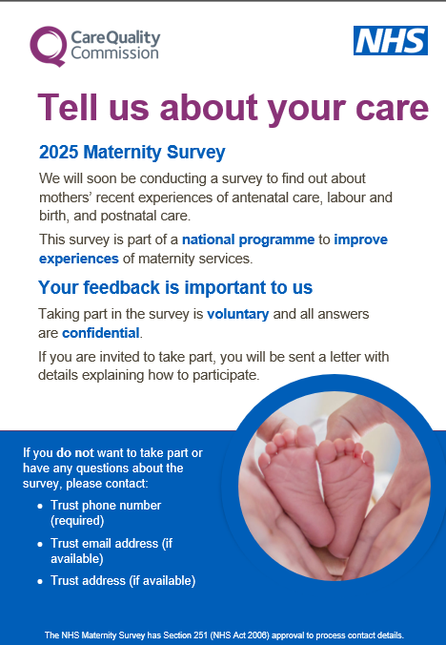
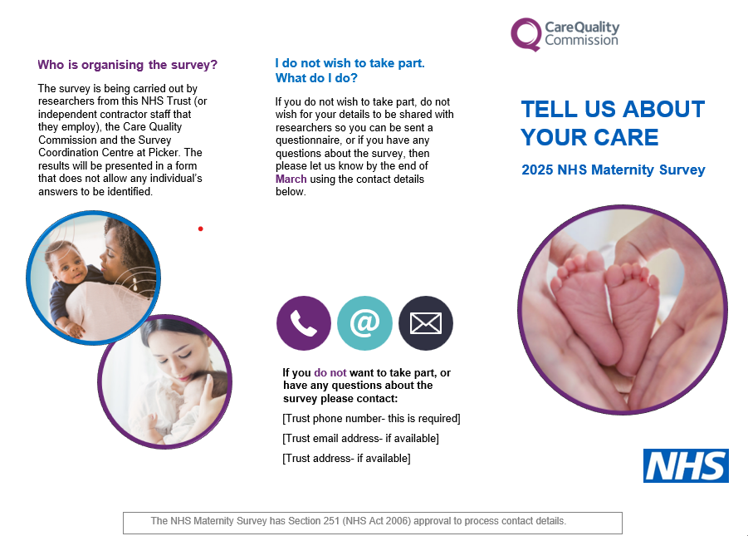
Section 251 requirements: dissent poster and 16/17-year-olds leaflet
Dissent posters give service users the opportunity to opt out (available on the NHS Surveys website).
Posters should be displayed during February (and January for trusts who need to sample back to reach 300 live births).
Posters are available in English, and have been translated into the most commonly spoken languages in England as well as languages requested by trusts. There are 24 translations available:
Arabic, Bengali, Bulgarian, Chinese Cantonese (Traditional), French, Gujarati, Hindi, Indian Punjabi, Italian, Kurdish Sorani, Lithuanian, Nepali, Polish, Portuguese, Pakistani Punjabi, Romanian, Russian, Somali, Spanish, Tamil, Tetum, Turkish, Ukrainian and Urdu.
A 16/17-year-olds leaflet should be shared with younger mothers postnatally in hospital or at discharge after birth in February (and January for smaller trusts).

Slide 28
Demographic Batch Service (DBS) Checks

Slide 29
DBS Requirements
Once you draw your sample of eligible service users, this list must be locally checked for deceased service users AND it must be submitted for demographic batch service (DBS) checks:
DBS & local checks requirements
Before mailing 1 | Local checks AND DBS checks at the time of drawing your sample Further deceased checks will be needed if it has been 2 weeks or more since DBS checks prior to sample submission and mailing 1
Before SMS 1 | No checks
Before mailing 2 | Local checks AND DBS checks
Before SMS 2 | No checks
Before mailing 3 | Local checks AND DBS checks
Before SMS 3 | No checks
Before mailing 4 | Local checks AND DBS checks

Slide 30
DBS Requirements
Some contractors have the capability of running DBS checks during fieldwork on the trusts’ behalf.
This removes the requirement for trusts to run DBS checks ahead of mailing two, mailing three and mailing four BUT:
Trusts are still required to run local checks between mailings.
Trusts are still expected to run the initial DBS checks when drawing the initial sample.
NHS Numbers of mother and baby and Full date of birth of mother and baby will be required in the sample sent to your contractor to allow them to conduct DBS checks on your behalf during fieldwork.
Please discuss further with your contractor.

Slide 31
Instruction manuals

Slide 32
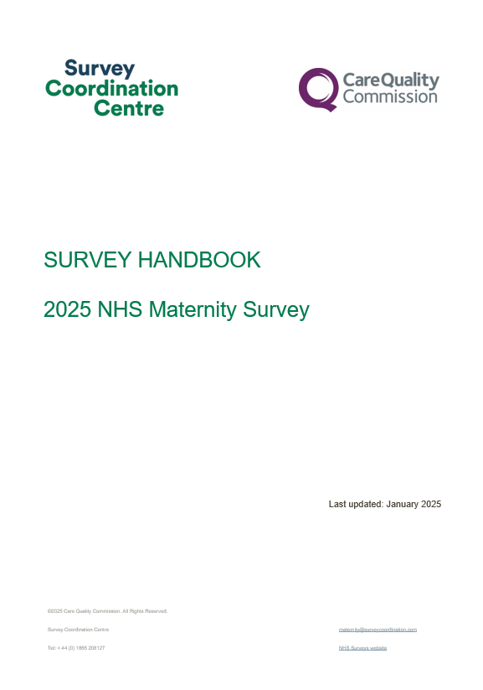
Survey Handbook
For survey leads:
Document outlining step-by-step process for preparing and running the survey.
It is a key summary document that links to all other relevant information regarding the survey handbook.
Includes:
What’s new for the 2025 Maternity Survey (including updated specifications for the online survey tool).
Tips on managing and implementing the survey.
Key dates: top level.
Highlights on key information e.g. S251.
This will be available on the NHS Maternity Survey website on 20th February

Slide 33
Sampling Instructions
For sample drawers (data team):
Document outlining step-by-step process of how to draw your sample.
Key summary document that links to all other relevant information regarding survey sampling.
Includes:
Overview of the sample drawing process.
Details on eligible and ineligible patients.
Information on DBS checks for deceased patients.
Checking and submitting your sample.
This will be available on the NHS Maternity Survey website on 20th February

Slide 34
Other Documents
Instruction Manuals: Sample Declaration Forms
Instruction Manuals: Sample Construction Worksheet
To be used to construct the sample of eligible patients for the survey
Two versions are available depending on whether you will be using a contractor to conduct fieldwork on your behalf or conducing the survey in-house.
Each version will contain all relevant fields for the sample details, mailing details and fieldwork variables.
To be used to check your sample has been correctly drawn before submission to your contractor or the SCC
Two versions are available depending on whether you will be using a contractor to conduct fieldwork on your behalf or conducing the survey inhouse.
Includes – instructions, checklist, declaration agreement.
Must be signed by the sample drawer AND your Caldicott Guardian prior to submission.
This will be available on the NHS Maternity Survey website on 20th February

Slide 35
Generic NPSP Instruction Documents
Other instructional documents that are useful for implementing the 2025 Maternity Survey can be found on the NHS Surveys website:
Patient feedback and the NHS Constitution
Setting up a project team
Data protection and confidentiality
Ethical issues, ethical committees and research governance
Collecting data from non-English speaking populations
Publicising the survey
Implementing the survey – practicalities
Submitting samples
Entering and submitting final data
Making sense of the data
Reporting results
Updated trust-level benchmark reports
Universal glossary

Slide 36
Entering fieldwork

Slide 37
Entering fieldwork early / on time
Entering fieldwork on time or earlier will help your trust to maximise responses from minority ethnic groups. You will also likely receive an overall higher response rate, providing your trust with more data.
Ensure you have a survey team in place before you start drawing your sample.
Generate your sample promptly - begin preparing now.
Respond to queries as soon as possible to avoid unnecessary delays.
Ensure there is sufficient resourcing around the time of drawing your sample and answering queries – communicate with your team, handover tasks if people are going to be on leave and let your contractor and the SCC know any updates.
If there are any changes in the survey lead, inform your contractor and the Survey Coordination Centre (SCC).

Slide 38
Key dates

Slide 39
Key dates
More detailed timelines can be found in the survey handbook for trusts managing sampling and recruitment in-house and for those using an approved contractor.
Activity | Date
Dissent posters published on website | December 2024
Dissent posters to be displayed | February 2025 and January 2025 for smaller trusts
Section 251 (approval) | January/February 2025
Publication of sampling materials | 20th February 2025
Publication of service user - facing materials (follows section 251 approval) | Mid-Late February 2025
Start drawing your sample | 3rd March 2025
Submit sample to contractor | Contractor to confirm
Sample checking (SCC) | 31st March-12th May 2025
Fieldwork | 22nd April-15th July 2025
Trusts receive local results | Autumn 2025

Slide 40
Questions

Slide 41
Thank you for your time
A copy of the slides will be on the NHS Surveys website
Contact us:
maternity@surveycoordination.com
01865 208127
Project Team (SCC):
Catherine Davidson (Research Associate), Chrysa Lamprinakou (Senior Research Associate), Caroline Killpack (Head of Survey Coordination)

